Slide 1
Dementia Training
www.qsource.org
Positive Approach to Care

Slide 2
Dementia| What is it?
It is BOTH a chemical change AND a structural change in the brain
This means
It may come and go
Sometimes they can and sometimes they can’t

Slide 3
Dementia| What Changes
Structural changes | permanent
Cells are shrinking and dying
Chemical changes | variable
Cells are producing and sending less chemicals
Can shine when least expected – chemical rush

Slide 4
Dementia equals brain failure
The person’s brain is dying
Dementia does not = Alzheimer’s does not = Memory Problems

Slide 5
Four truths about dementia
At least two parts of the brain are dying
It is chronic and can’t be fixed
It is progressive and will get worse
It is terminal

Slide 6
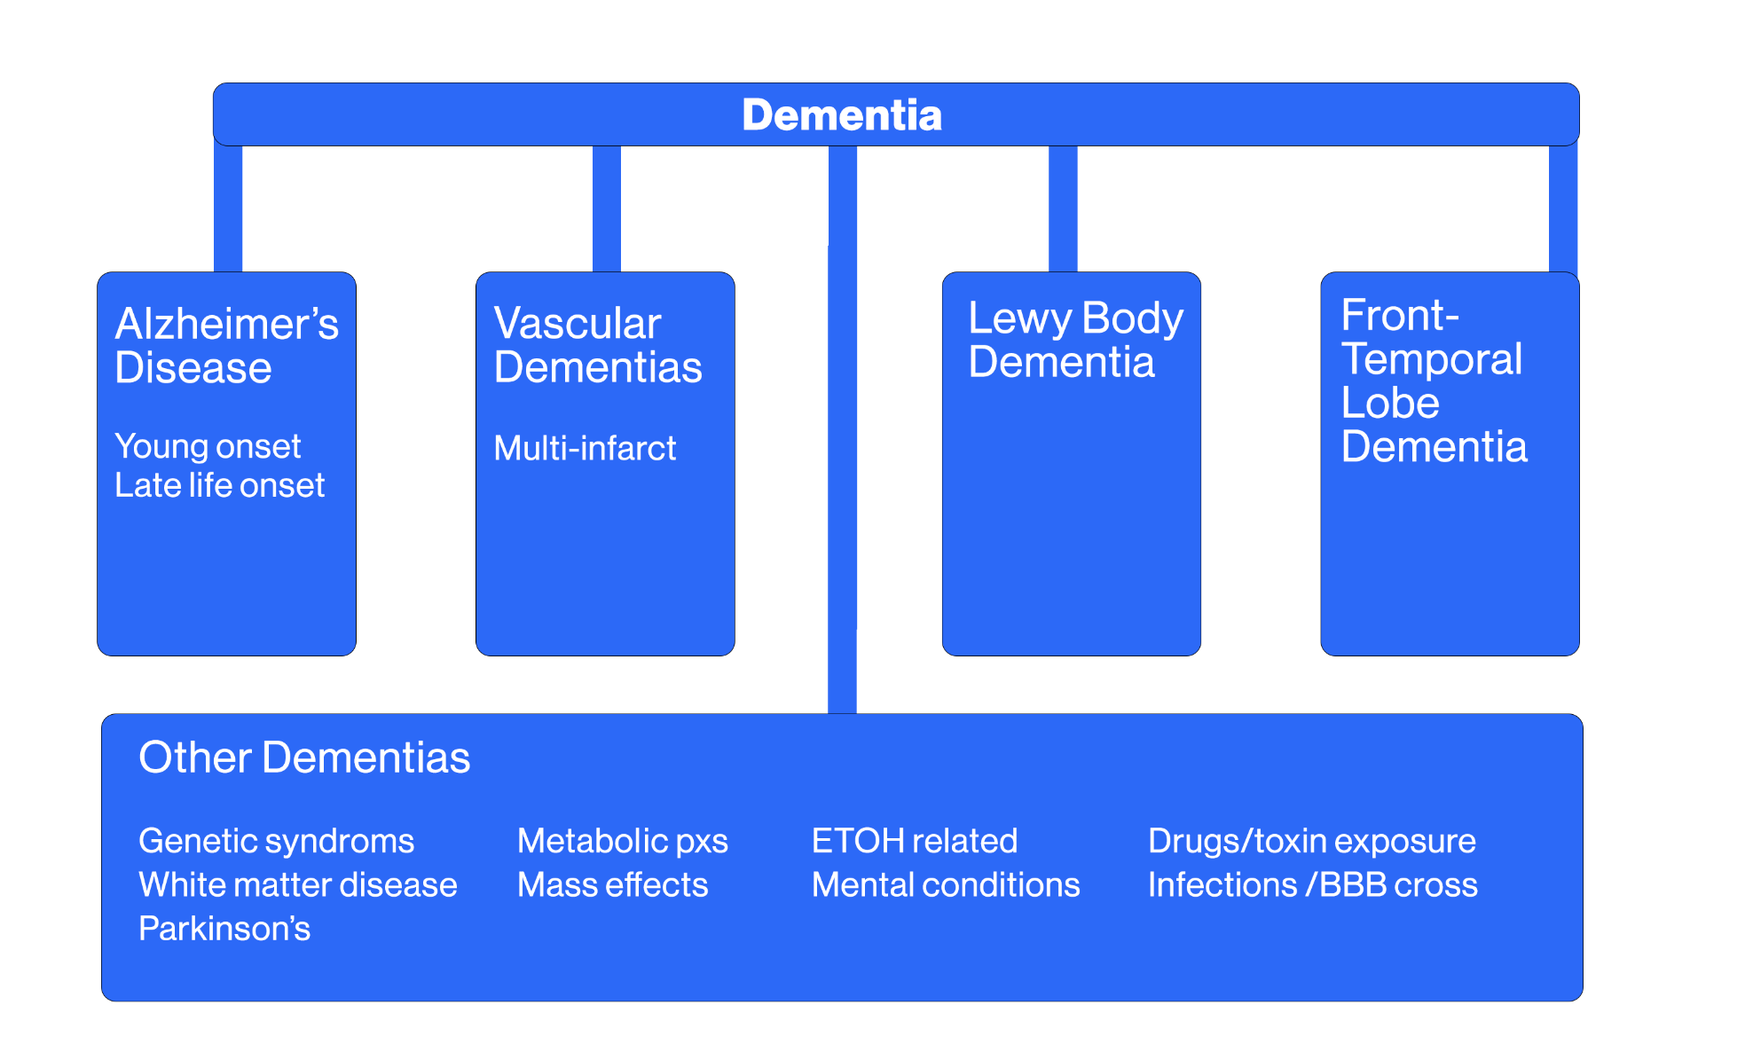
Dementia

Slide 7
Alzheimer’s
New information is lost
Recent memory worsens
Problems with word finding
May misspeak
Will become more impulsive and indecisive
Gets lost
Changes are noticeable every 6-12 months
Typically lasts 8-12 years

Slide 8
Mild Cognitive Impairment (MCI)
MCI is the beginning of a not-normal condition
Memory
Language
Behavior
Motor skills
Not life altering, BUT definitely different

Slide 9
Is MCI always Dementia?
Could be a form of dementia
Symptom of another health condition
Medication side-effect
Hearing or vision loss
Depression
Delirium
Pain-related

Slide 10
Mimics of Dementia Symptoms
Depression
Can’t think
Can’t remember
Not worth it
Loss of function
Mood swings
Personality change
Change in sleep
Delirium
Swift change
Hallucinations
Delusions
On/off responses
Infection
Toxicity
Dangerous

Slide 11
If you notice changes
You should:
Get an assessment
Go see the doctor

Slide 12
Dementia
It changes everything over time
It is NOT something a person can control
It is NOT the same for every person
It is NOT a mental illness
It is real
It is very hard at times

Slide 13
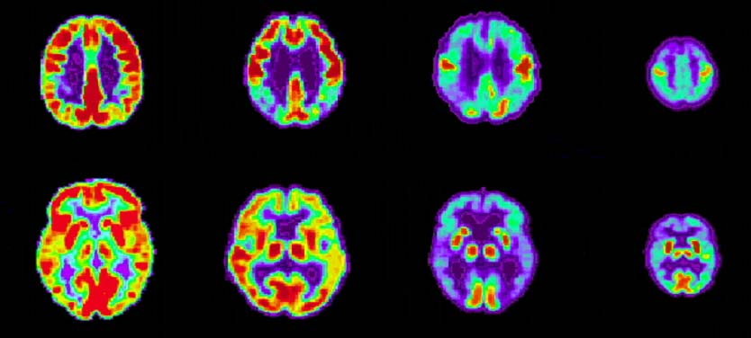
Positron Emission Tomography (PET) Alzheimer’s Disease Progression vs. Normal Brains

Slide 14
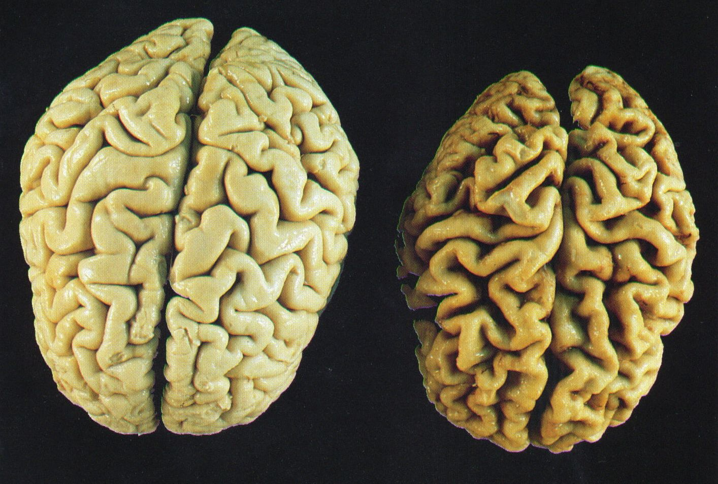
Normal vs. Alzheimer’s Brain

Slide 15
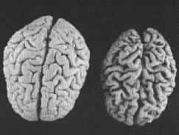
Brain Atrophy
The brain actually shrinks
Cells wither, then die
Abilities are lost
With Alzheimer’s, areas of loss are fairly predictable
BUT the experience is individual

Slide 16
Vision Center | Big Changes

Slide 17
Vision Changes
Losses
Edges of vision, peripheral field
Depth perception
Object recognition linked to purpose
SLOWER to process: scanning and shifting focus
Preserved
See things in middle field
Looking at…curious

Slide 18
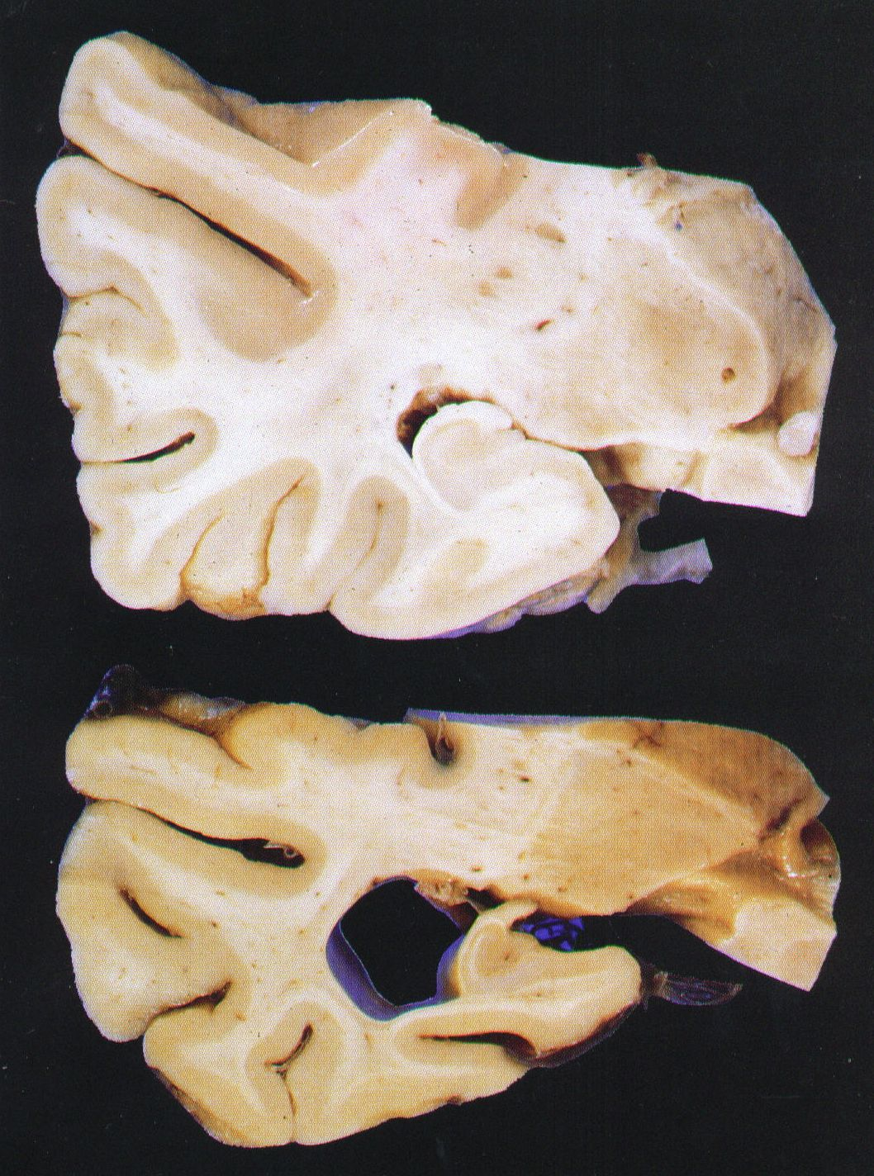
Learning and Memory Center
Hippocampus: BIG CHANGE

Slide 19
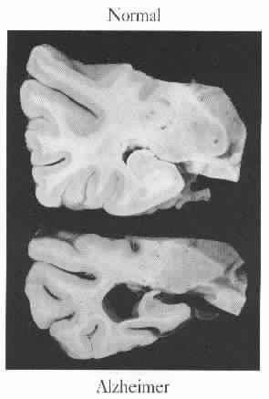
Memory Loss | Normal vs. Alzheimer
Loss
Immediate recall
Attention to selected info
Recent events
Relationships
Preserved Ability
Long ago memories
Confabulation
Emotional memories
Motor memories

Slide 20
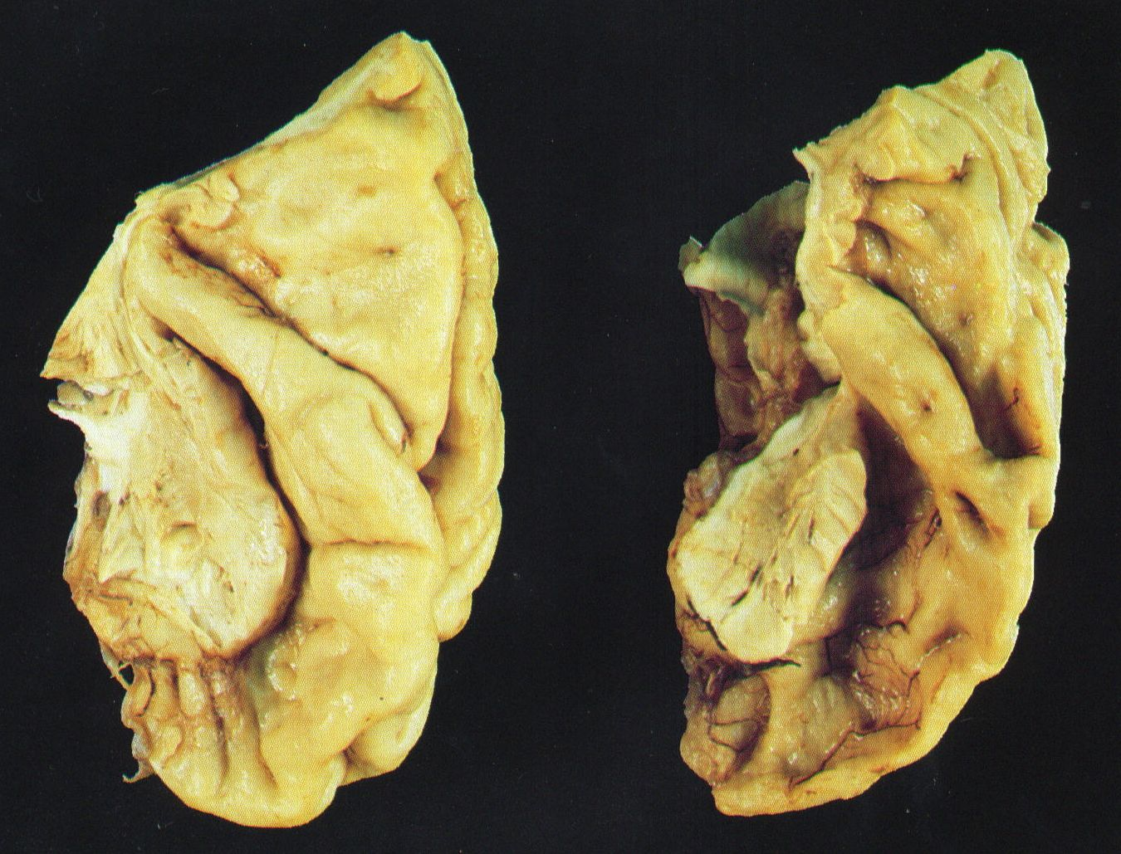
Understanding Language | Big Change

Slide 21
Hearing of Sound | Not Changed

Slide 22
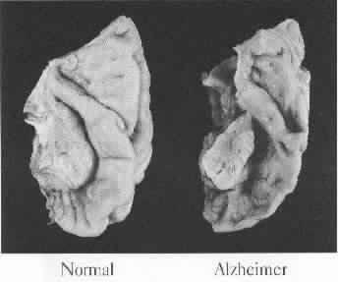
Understanding
Loss
Can’t interpret words
Misses some words
Gets off target
Preserved Ability
Can get facial expression
Hears tone of voice
Can get some non-verbals
Learns how to cover

Slide 23
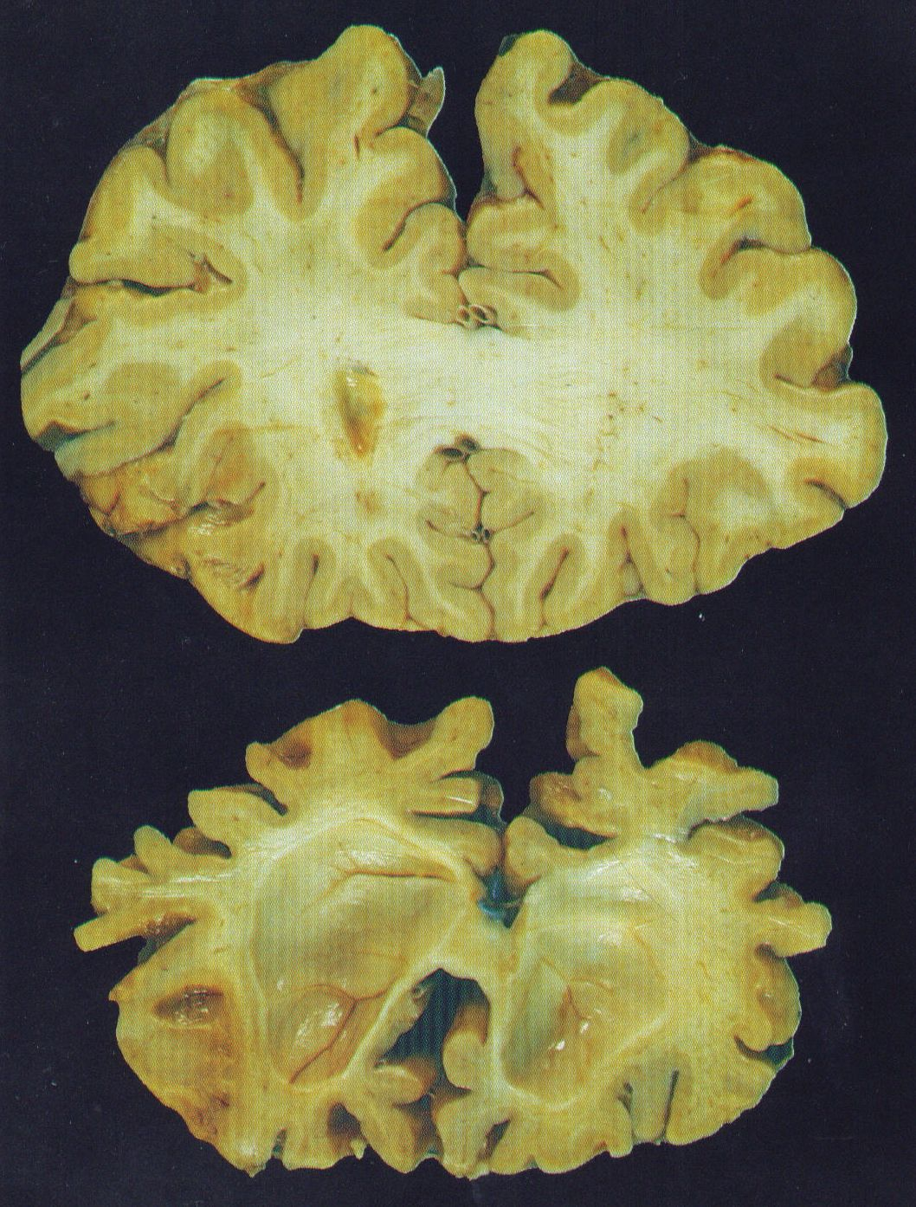
Executive Control Center
Emotions
Behavior
Judgment
Reasoning

Slide 24
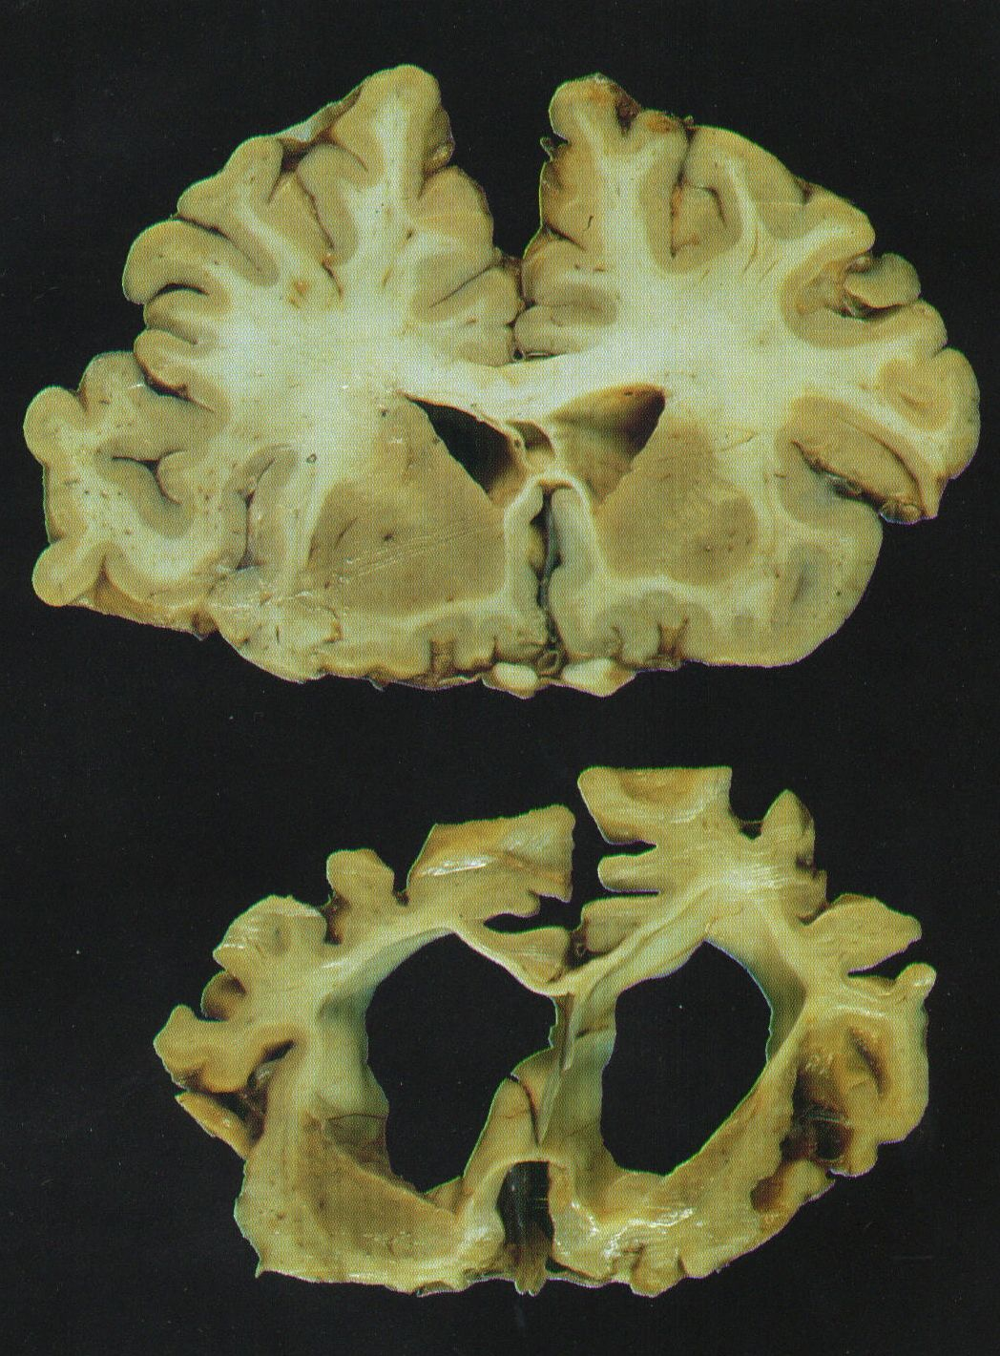
Executive Control Center (cont.)
Big Changes
Sensory strip
Monitor strip
White matter
Connections
Preserved
Automatic speech
Rhythm/Music
Expletives
Huge Changes
Formal Speech
Language Center

Slide 25
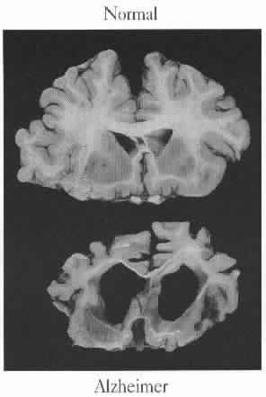
Sensory Changes
Loss
Awareness of body and position
Ability to locate and express pain
Awareness of feeling in most of body
Preserved Ability
Four areas can be sensitive
Any of these areas can be hypersensitive
Need for sensation can become extreme

Slide 26
Self-Care Changes
Loss
Initiation and termination
Tool manipulation
Sequencing
Preserved Ability
Motions and actions
The doing part
Cued activity

Slide 27
Language Changes
Loss
Can’t find the right words
Word salad
Vague language
Single phrases
Sounds and vocalizing
Can’t make needs known
Preserved Ability
Motions and actions
The doing part
Cued activity

Slide 28
Language Changes (cont.)
Preserved Ability
Singing
Automatic speech
Swear words, sex talk, forbidden words

Slide 29
Normal Aging Brain
Can’t recall a word. Describe the word to get it to pop up.
Give people time to process information. Go more slowly.
Slower to think.
Slower to do.
May hesitate more.
More likely to look before they leap.
Will know the person, but not find the name.
May pause when word finding.
New data reminds me of old data.

Slide 30
Use Hand-Under-Hand
Connecting – comforting and directing gaze
Guiding and helping with movement
Getting eye contact and attention
Providing help with fine motor
Offering a sense of control, even when you are doing almost everything

Slide 31
Not Normal Aging Brain
Unable to think the same
Unable to do as before
Unable to get started on a task
Will get stuck in a moment of time
Unable to think things out
Unable to successfully place a person
Words won’t come even with visual, verbal, or touch cues
Confused between past and present
Personality and/ or behaviors will be different

Slide 32
The Basics for Success
Realize…it takes TWO to tango…Or TWO to tangle!
Be a Detective NOT a Judge
Look, Listen, Offer, Think…
Use Your Approach as a Screening Tool
Always use this sequence for CUES
Visual - Show
Verbal - Tell
Physical – Touch
Match your help to remaining abilities

Slide 33
Build Skill
Positive Physical Approach™
Supportive Communication
Consistent and Skill Sensitive Cues
Visual, verbal, physical
Hand-Under-Hand™
for connection
for assistance
Open and Willing Heart, Head and Hands

Slide 34
Approach Matters
Use a consistent Positive Physical Approach™
Pause at edge of public space
Gesture and greet by name
Offer your hand and make eye contact
Approach slowly within visual range
Shake hands and maintain Hand-Under-Hand™
Move to the side
Get to eye level & respect intimate space
Wait for acknowledgement

Slide 35
Supportive Communication
Make a connection
Offer your name – “I’m (NAME)… and you are…”
Offer a shared background – “I’m from (place) …and you’re from…”
Offer a positive personal comment – “You look great in that ….” or “I love that color on you…”

Slide 36
Emotional Communication
Validate emotions
EARLY –“It’s really (label emotion) to have this happen” or “I’m sorry this is happening to you”
MIDWAY – Repeat/reflect their words (with emotion)
LISTEN for added information, ideas, thoughts
EXPLORE the new information by ‘watching and listening’ (wonder what they are trying to communicate)
LATE – Check out their ‘whole’ body –
Observe face, posture, movement, gestures, touching, looking
Look for NEED under the words or actions

Slide 37
Keep it Simple
USE VISUAL combined with VERBAL (gesture/point)
“It’s about time for… “
“Let’s go this way…”
“Here are your socks…”
DON’T ask questions you DON’T want to hear the answer to…
Acknowledge the response/reaction to your information…
LIMIT your words – SIMPLE is better always
Wait, Pause, Slow Down

Slide 38
When words don’t work well
Hand-under-Hand™
Uses established nerve pathways
Allows the person to feel in control
Connects you to the person
Allows you to do with not to
Gives you advance notice of ‘possible problems’
Connects eye-hand skills
Use the dominant side of the person

Slide 39
For ALL Communication
If what you are trying is NOT working
STOP
Back off
THINK IT THROUGH…
Then, re-approach
And try something slightly different

Slide 40
Care partners
Need to:
Take care of yourself
Understand the symptoms and progression
Build skill in support and caregiving
Build skill in communication and interactions
Understand ‘the condition’ of brain change
Identify and utilize local resources
Set limits for yourself

Slide 41
Gem Dementia Abilities based on Allen Cognitive Levels
A Cognitive Disability Theory – OT based
Creates a common language and approach to providing:
Environmental support
Caregiver support and cueing strategies
Expectations for retained ability and lost skill
Promotes graded task modification
Each Gem state requires a special ‘setting’ and ‘just right’ care
Visual, verbal, touch communication cues
Each can shine
Encourages in the moment assessment of ability and need
Accounts for chemistry as well as structure change

Slide 42
GEMSTM
Sapphires True Blue Slower BUT Fine
Diamonds Repeats and routines, cutting
Emeralds Going Time travel/where?
Ambers In the moment Sensations
Rubies Stop and Go No fine control
Pearls Hidden in a shell Immobile

Slide 43
Positive approach to care
People living with dementia need care partners to think about and act on what they want, need and think.
Watch and observe
What they show you – how they look
What they say – how they sound
What they do – physical reactions

Slide 44
Thank You
www.qsource.org
Questions?
Disclaimer | This material was prepared by Qsource, a/an Network of Quality Improvement and Innovation Contractors under contract with the Centers for Medicare & Medicaid Services (CMS), an agency of the U.S. Department of Health and Human Services (HHS). Views expressed in this document do not necessarily reflect the official views or policy of CMS or HHS, and any reference to a specific product or entity herein does not constitute endorsement of that product or entity by CMS or HHS. 22.QIO1.06.017

